Slide 1
Gradient descent
Stochastic gradient descent

Slide 2
Definition
Gradient descent is a first-order iterative optimization algorithm for finding a local minimum of a differentiable function
Gradient descent is an optimization algorithm used to find the values of parameters (coefficients) of a function (f) that minimizes a cost function (cost).
Gradient descent is best used when the parameters cannot be calculated analytically (e.g. using linear algebra) and must be searched for by an optimization algorithm.

Slide 3
Batch gradient descent
Batch Gradient Descent is when we sum up over all examples on each iteration when performing the updates to the parameters
The main advantages:
We can use fixed learning rate during training without worrying about learning rate decay.
It has straight trajectory towards the minimum and it is guaranteed to converge in theory to the global minimum if the loss function is convex and to a local minimum if the loss function is not convex.
It has unbiased estimate of gradients. The more the examples, the lower the standard error.
The main disadvantages:
Even though we can use vectorized implementation, it may still be slow to go over all examples especially when we have large datasets.
Each step of learning happens after going over all examples where some examples may be redundant and don’t contribute much to the update

Slide 4
Mini-batch Gradient Descent
Instead of going over all examples, Mini-batch Gradient Descent sums up over lower number of examples based on the batch size
The main advantages:
Faster than Batch version because it goes through a lot less examples than Batch (all examples).
Randomly selecting examples will help avoid redundant examples or examples that are very similar that don’t contribute much to the learning.
With batch size < size of training set, it adds noise to the learning process that helps improving generalization error.
Even though with more examples the estimate would have lower standard error, the return is less than linear compared to the computational burden we incur.
The main disadvantages:
It won’t converge. On each iteration, the learning step may go back and forth due to the noise. Therefore, it wanders around the minimum region but never converges.
Due to the noise, the learning steps have more oscillations (see figure 4) and requires adding learning-decay to decrease the learning rate as we become closer to the minimum.

Slide 5
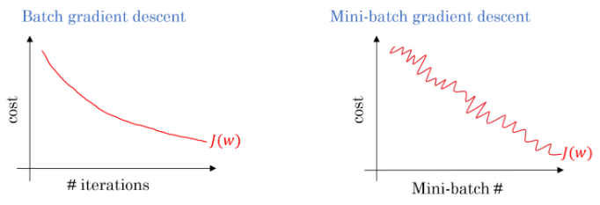
batch versus mini-batch loss function

Slide 6
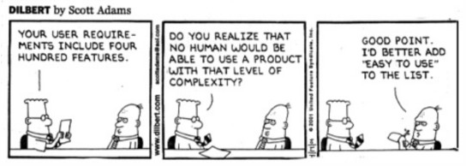

Slide 7
stochastic gradient descent
Gradient descent can be slow to run on very large datasets.
Because one iteration of the gradient descent algorithm requires a prediction for each instance in the training dataset, it can take a long time when you have many millions of instances.
In situations when you have large amounts of data, you can use a variation of gradient descent called stochastic gradient descent.
In this variation, the gradient descent procedure described above is run but the update to the coefficients is performed for each training instance, rather than at the end of the batch of instances.
The first step of the procedure requires that the order of the training dataset is randomized.
This is to mix up the order that updates are made to the coefficients. Because the coefficients are updated after every training instance, the updates will be noisy jumping all over the place, and so will the corresponding cost function.
By mixing up the order for the updates to the coefficients, it harnesses this random walk and avoids it getting distracted or stuck.
The update procedure for the coefficients is the same as gradient descent, except the cost is not summed over all training patterns, but instead calculated for one training pattern.
The learning can be much faster with stochastic gradient descent for very large training datasets and often you only need a small number of passes through the dataset to reach a good or good enough set of coefficients.

Slide 8
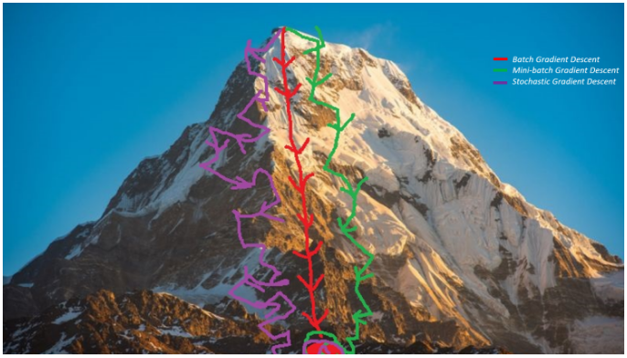
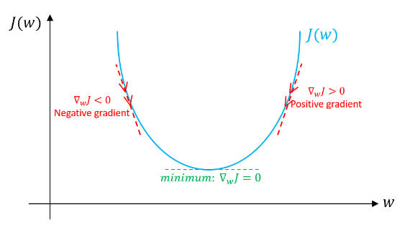
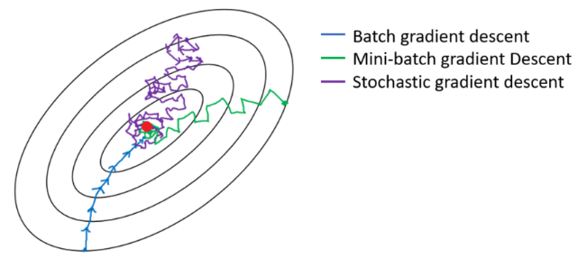
Local minima
Gradient descent. An illustration of how gradient descent algorithm uses the first derivative of the loss function to follow downhill it’s minimum.
Gradient descent variants’ trajectory towards minimum

Slide 9
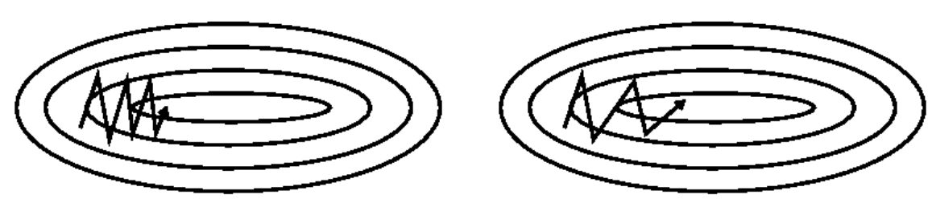
Gradient descent with momentum
SGD without momentum, right— SGD with momentum
Techniques designed to speed up convergence of first order optimization methods
Momentum helps accelerate gradients in the right direction
During backward propagation, we use dW update our parameters W:
W = W – learning rate * dW
In momentum, instead of using dW independently for each epoch, we take the exponentially weighted averages of dW
V_{dW} = β x V_{dW} + (1 – β) x dW
Where beta ‘β’ is another hyper-parameter called momentum and ranges from 0 to 1.
After calculating exponentially weighted averages, we will update our parameters.
W = W – learning rate *V_{dW}

Slide 10
Gradient descent vs stochastic GD
While in Gradient Descent (GD) the whole Training Set is considered before taking one Model Parameters Update Step, in Stochastic Gradient Descent (SGD) only one Data Point is considered for each Model Parameters Update Step, cycling over the Training Set.

Slide 11
amount of data for training neural networks
The amount of data required for machine learning depends on many factors, such as:
The complexity of the problem, nominally the unknown underlying function that best relates your input variables to the output variable.
The complexity of the learning algorithm, nominally the algorithm used to inductively learn the unknown underlying mapping function from specific examples.
it is common to perform studies on how algorithm performance scales with dataset size

Slide 12
number of hidden layers required
Artificial neural networks have two main hyper-parameters that control the architecture or topology of the network: the number of layers and the number of nodes in each hidden layer
A single-layer neural network can only be used to represent linearly separable functions
How Many Layers and Nodes to Use?
Use systematic experimentation to discover what works best for your specific dataset.
The intuition can come from experience with the domain, experience with modeling problems with neural networks, or some mixture of the two.
intuitions are often invalidated via experiments.

Slide 13
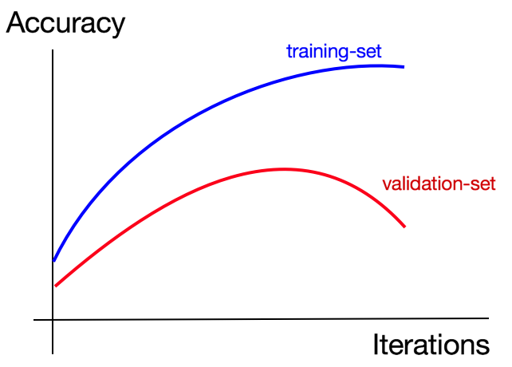
when to stop training neural networks
Stop training when the validation error is the minimum.
What determines the number of epoch?
If training and validation are both low, you are probably under fitting and you can probably increase the capacity of your network and train more or longer (increase the number of epochs).
If there is an inflection point when training goes above the validation, you might be able to use early stopping(stop training).

